Slide 1

The Battle of the Neighborhoods
Applied Data Science Capstone

Slide 2

Content
Background
Data
Methodology
Results
Discussion and Conclusion

Slide 3
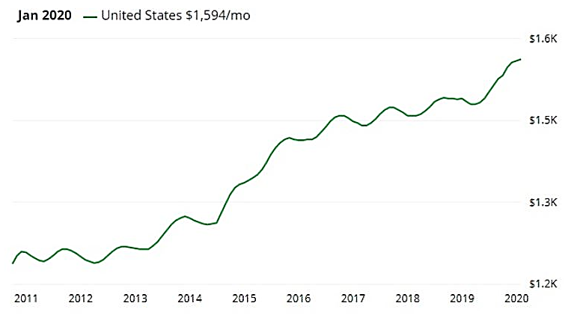
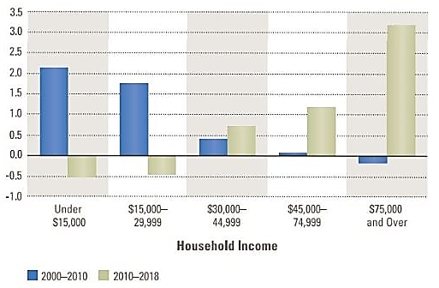
Background
State of the rental housing market in the United States
The role of the high-income segment in this market
Relevance of current strategy

Slide 4
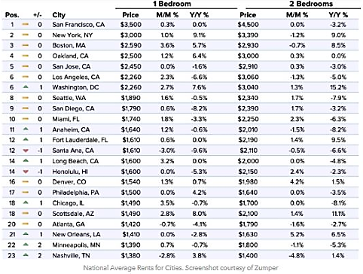
Background
Opportunities that are not being seized
Changes suggested for current strategy: Diversify Californian Portfolio

Slide 5

Data
Zillow (ZRI Index)
Geocoder
FourSquare

Slide 6
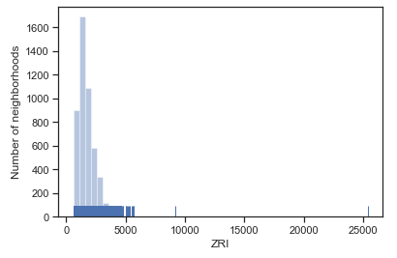
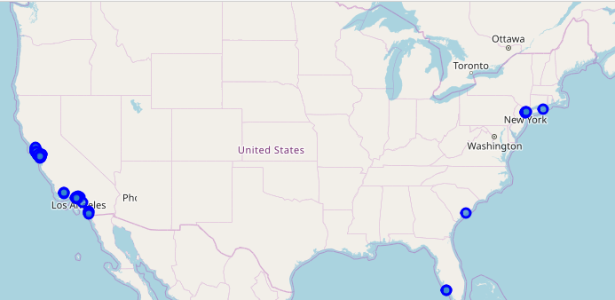
Methodology
Zillow Database
List of 100 neighborhoods with most expensive rents in the U.S
Geocoder for position information

Slide 7
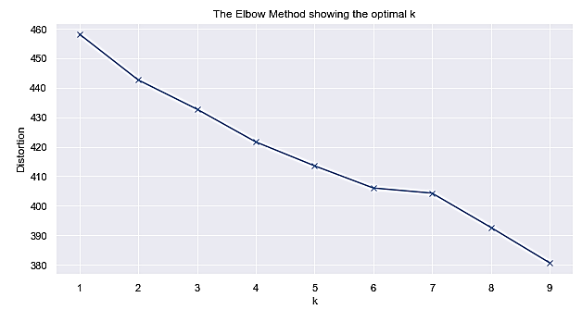
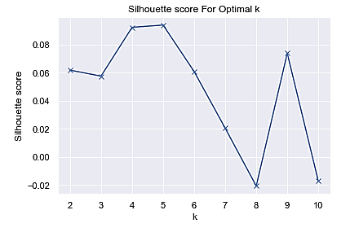
Methodology
Clustering Method: K-Means
Optimal K
Elbow Method
Silhouette Method

Slide 8
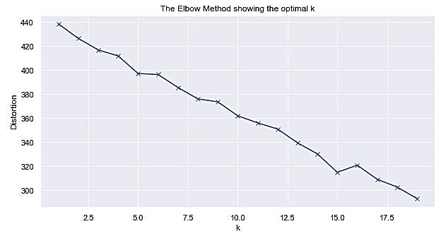
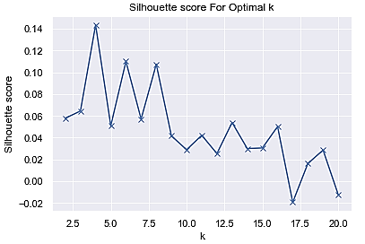
Methodology
Errors: Correct Duplicate Values
Repeat Previous Steps
Inspect the clusters

Slide 9
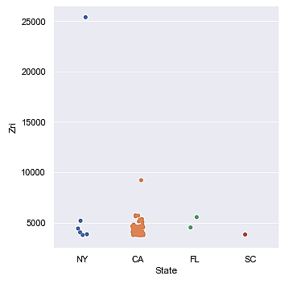
Results
First Deliverable (Top 100)
Export to client
Analysis of distribution

Slide 10
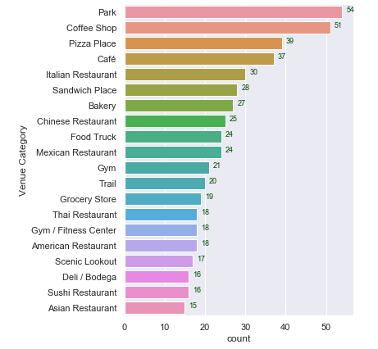
Results
Second Deliverable (Most Common Venues)
20 most common venues
Comfort and well-being

Slide 11
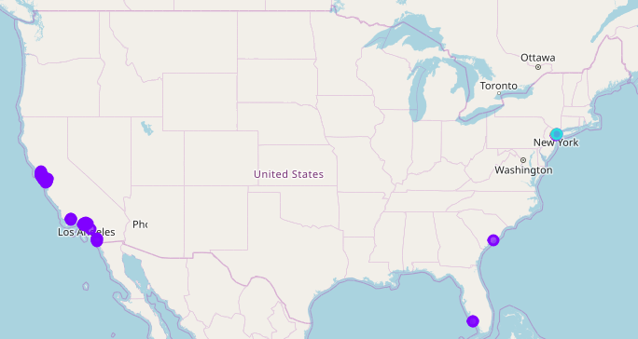
Results
Third Deliverable (Clusters)
Cluster composition
Possible matches for the profile the client is looking for
Export database to client

Slide 12

Discussion
Limitations
FourSquare API
Features of the model
K-Means algorithm
Suggestions for future projects
More features
Database from actual customers that moved from California
Qualitative Surveys
Increase robustness of classification

Slide 13

Conclusion
Business Intelligence for the Client
Data Collection
Machine Learning Solutions
Esta foto de Autor desconocido está bajo licencia CC BY-SA-NC

Slide 14


IBM DATA SCIENCE PROFESSIONAL cERTIFICATE
Coursera

